Slide 1
Redes Convolucionales para Clasificación de Imágenes

Slide 2
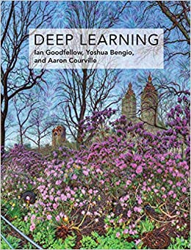
Lectura Recomendada
Deep Learning
Ian Goodfellow and Yoshua Bengio and Aaron Courville
https://www.deeplearningbook.org/

Slide 3
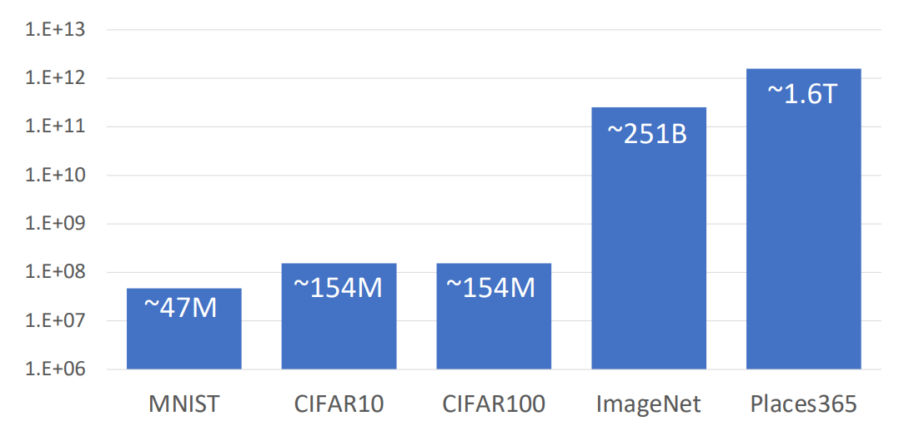
Datasets de clasificación: número de pixels de entrenamiento
https://web.eecs.umich.edu/~justincj/slides/eecs498/FA2020/598_FA2020_lecture02.pdf

Slide 4
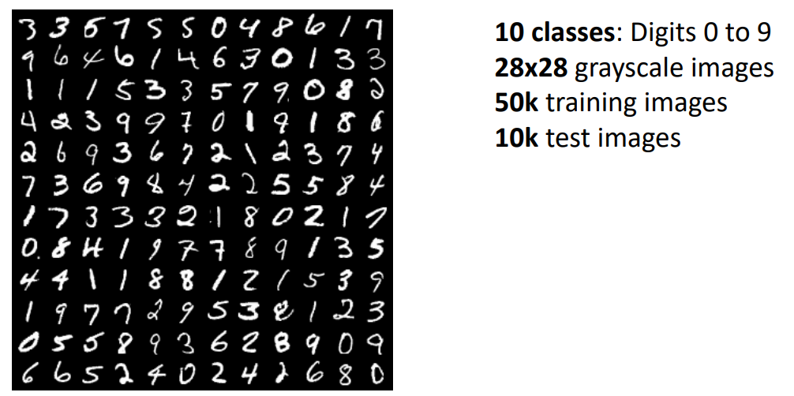
Datasets de clasificación: MNIST
https://web.eecs.umich.edu/~justincj/slides/eecs498/FA2020/598_FA2020_lecture02.pdf

Slide 5
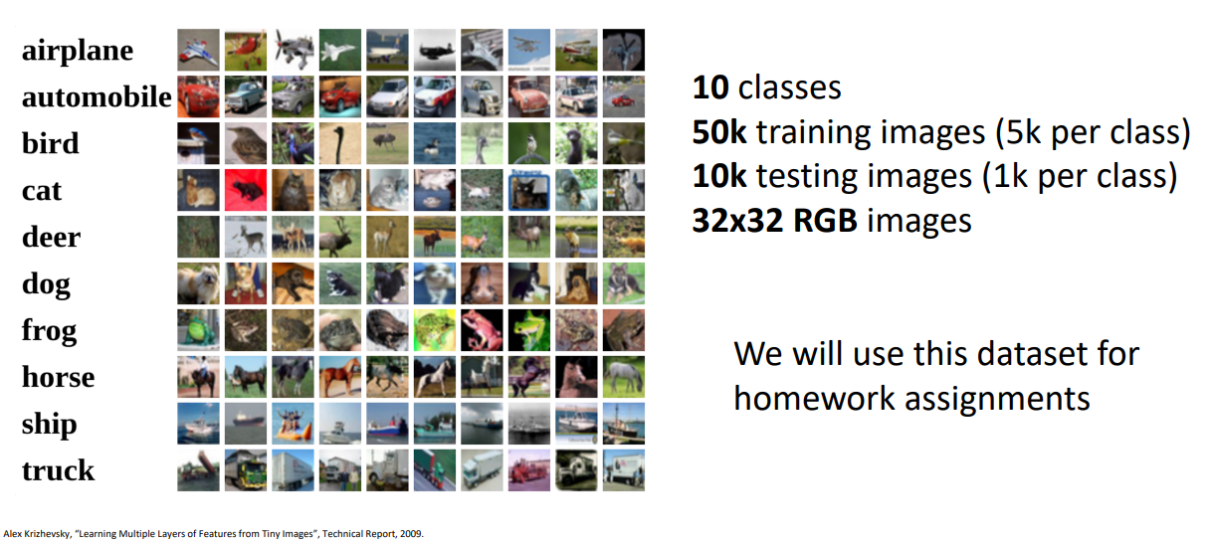
Datasets de clasificación: CIFAR-10
https://web.eecs.umich.edu/~justincj/slides/eecs498/FA2020/598_FA2020_lecture02.pdf

Slide 6
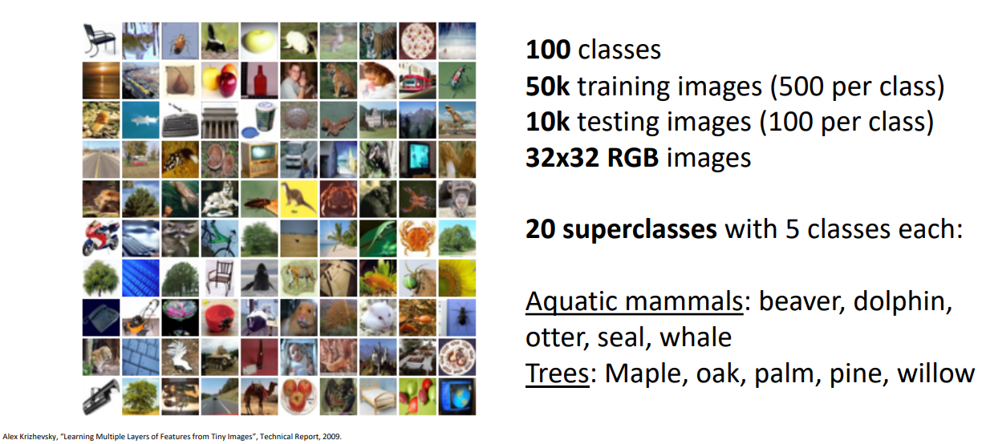
Datasets de clasificación: CIFAR-100
https://web.eecs.umich.edu/~justincj/slides/eecs498/FA2020/598_FA2020_lecture02.pdf

Slide 7
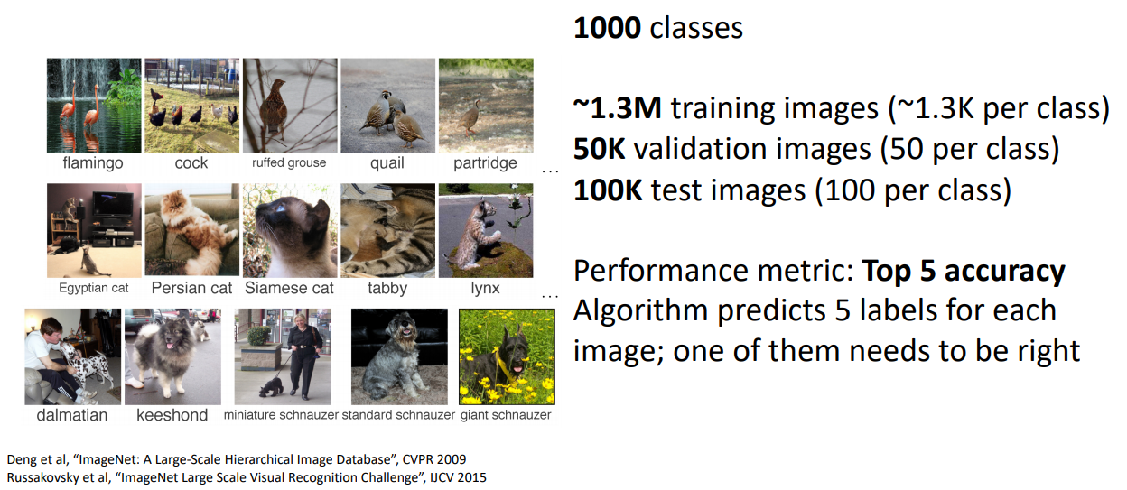
Datasets de clasificación: ImageNet
https://web.eecs.umich.edu/~justincj/slides/eecs498/FA2020/598_FA2020_lecture02.pdf

Slide 8
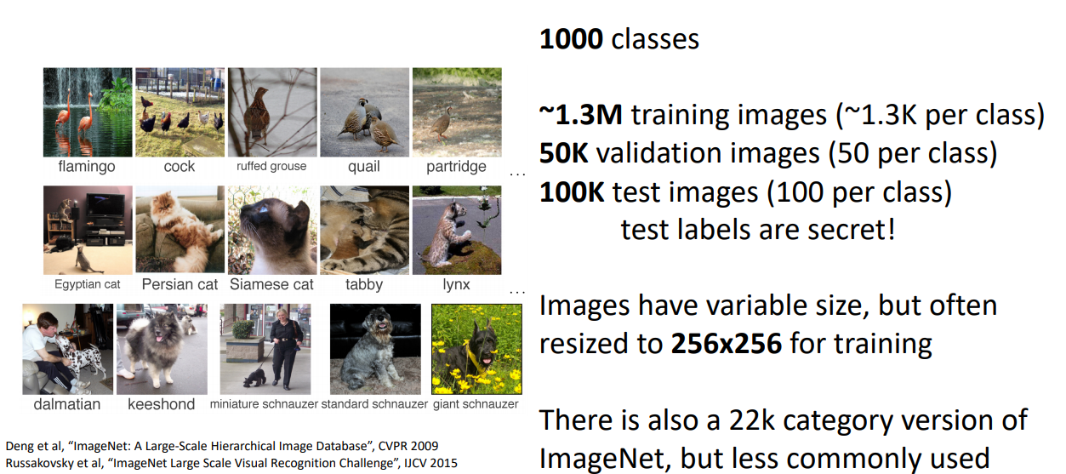
Datasets de clasificación: ImageNet
https://web.eecs.umich.edu/~justincj/slides/eecs498/FA2020/598_FA2020_lecture02.pdf

Slide 9
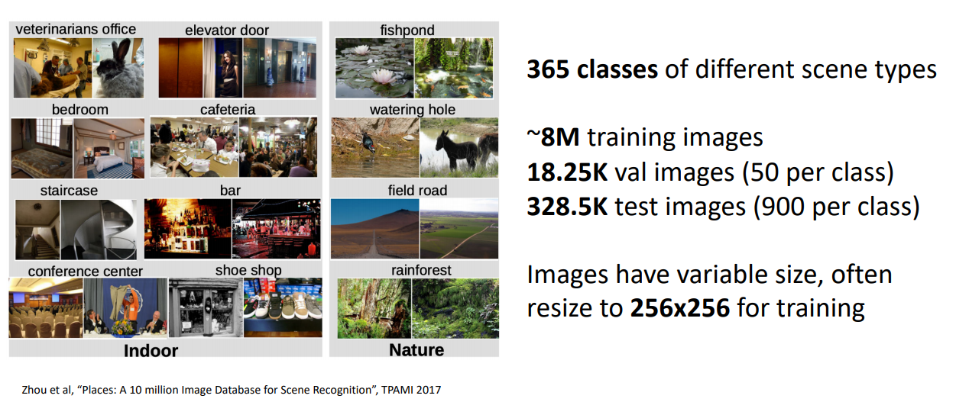
Datasets de clasificación: MIT Places
https://web.eecs.umich.edu/~justincj/slides/eecs498/FA2020/598_FA2020_lecture02.pdf

Slide 10
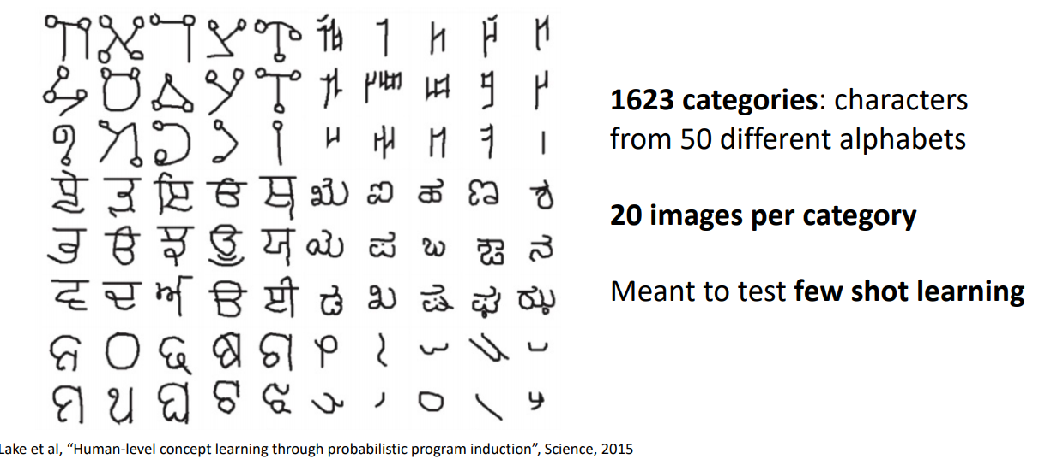
Datasets de clasificación: Omniglot
https://web.eecs.umich.edu/~justincj/slides/eecs498/FA2020/598_FA2020_lecture02.pdf

Slide 11
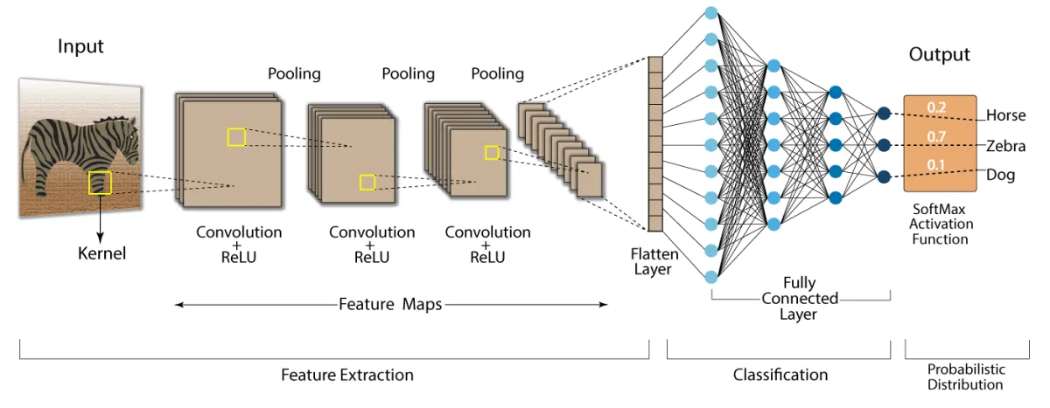
Arquitecturas Convolucionales para clasificación
https://i0.wp.com/developersbreach.com/wp-content/uploads/2020/08/cnn_banner.png?fit=1200%2C564&ssl=1

Slide 12
ImageNet
15 millones de imágenes etiquetadas (high-res)
22K categorías
ILSVRC (la competencia)
  1000 clases
  1000 categorías
  1.3M training
  50K validación
  100K test
ILSVRC 2014 Ranking
http://www.image-net.org/challenges/LSVRC/2014/results#clsloc

Slide 13
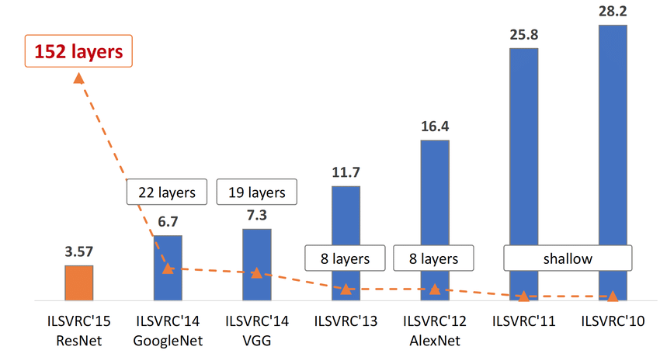
ILSVRC: Profundidad vs. Error
ILSVRC Ranking
https://www.researchgate.net/profile/Kien-Nguyen-23/publication/321896881/figure/fig1/AS:573085821489153@1513645715549/The-evolution-of-the-winning-entries-on-the-ImageNet-Large-Scale-Visual-Recognition.png

Slide 14
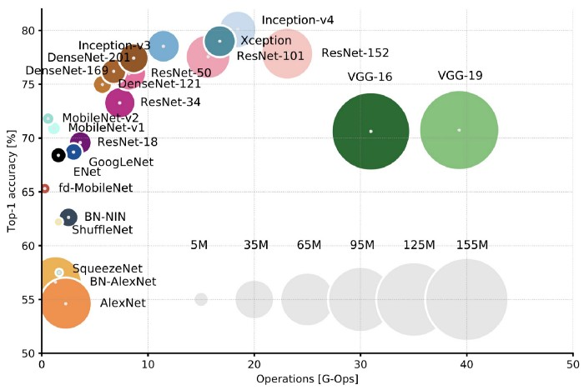
Redes y Cantidad de Operaciones
Canziani, A., Paszke, A., & Culurciello, E. (2016). An analysis of deep neural network models for practical applications. arXiv preprint arXiv:1605.07678.
https://culurciello.medium.com/analysis-of-deep-neural-networks-dcf398e71aae updated Figure 2: Top1 vs. operations, size ∝ parameters. Top-1 one-crop accuracy versus amount of operations required for a single forward pass. The size of the blobs is proportional to the number of network parameters; a legend is reported in the bottom right corner, spanning from 5×10^6 to 155×10^6 params. Both these figures share the same y-axis, and the grey dots highlight the centre of the blobs.

Slide 15
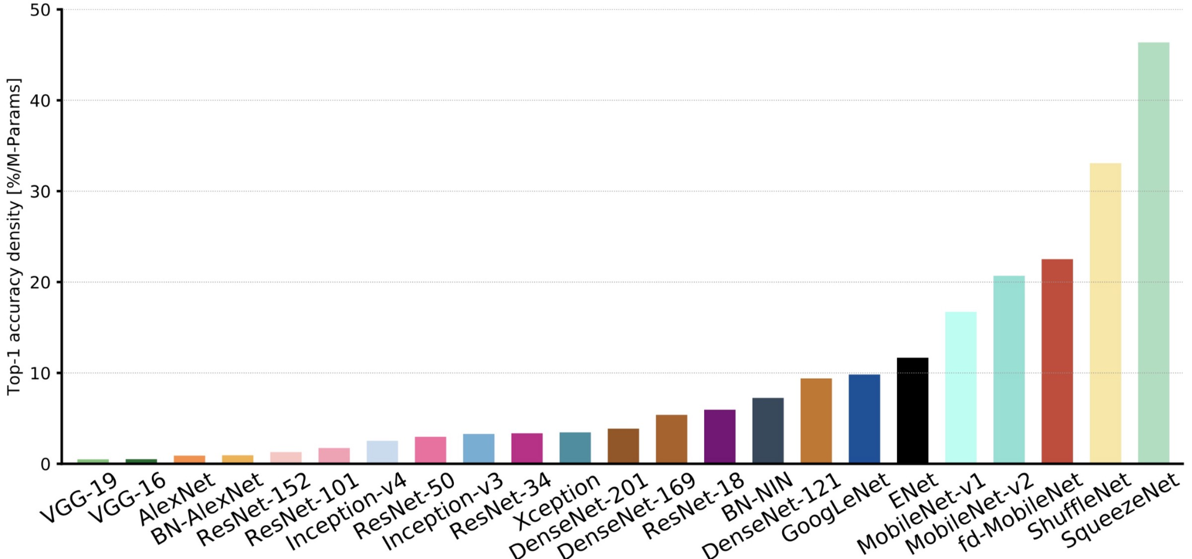
Redes y Cantidad de Operaciones
Canziani, A., Paszke, A., & Culurciello, E. (2016). An analysis of deep neural network models for practical applications. arXiv preprint arXiv:1605.07678.
https://culurciello.medium.com/analysis-of-deep-neural-networks-dcf398e71aae updated Figure 10: Accuracy per parameter vs. network. Information density (accuracy per parameters) is an efficiency metric that highlight that capacity of a specific architecture to better utilise its parametric space. Models like VGG and AlexNet are clearly oversized, and do not take fully advantage of their potential learning ability. On the far right, ResNet-18, BN-NIN, GoogLeNet and ENet (marked by grey arrows) do a better job at “squeezing” all their neurons to learn the given task, and are the winners of this section.

Slide 16
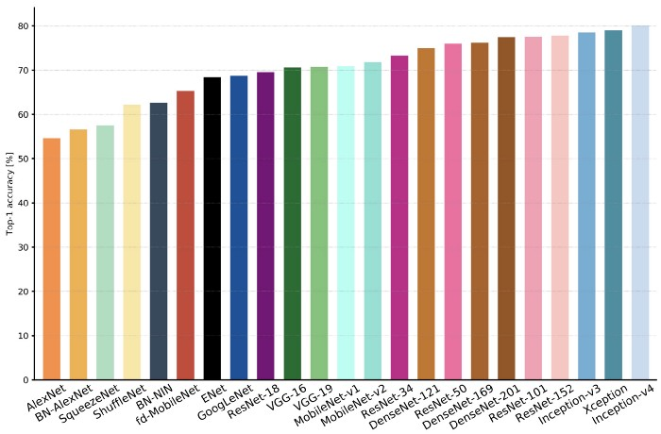
Redes y Cantidad de Operaciones
Canziani, A., Paszke, A., & Culurciello, E. (2016). An analysis of deep neural network models for practical applications. arXiv preprint arXiv:1605.07678.
https://culurciello.medium.com/analysis-of-deep-neural-networks-dcf398e71aae updated Figure 1: Top1 vs. network. Single-crop top-1 validation accuracies for top scoring single-model architectures. We introduce with this chart our choice of colour scheme, which will be used throughout this publication to distinguish effectively different architectures and their correspondent authors. Notice that networks of the same group share the same hue, for example ResNet are all variations of pink.

Slide 17
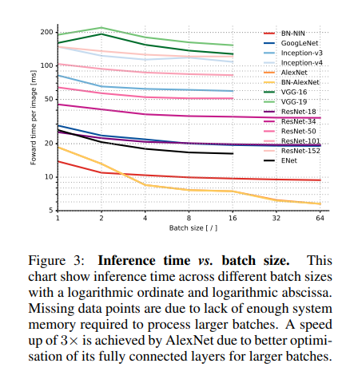
Redes y Cantidad de Operaciones
Canziani, A., Paszke, A., & Culurciello, E. (2016). An analysis of deep neural network models for practical applications. arXiv preprint arXiv:1605.07678.

Slide 18
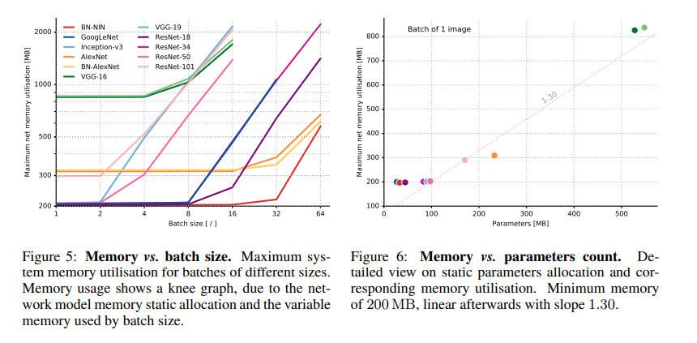
Redes y Cantidad de Operaciones
Canziani, A., Paszke, A., & Culurciello, E. (2016). An analysis of deep neural network models for practical applications. arXiv preprint arXiv:1605.07678.

Slide 19
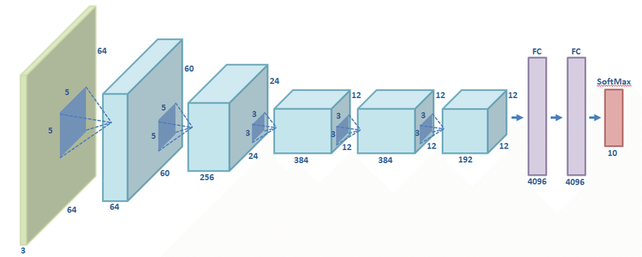
AlexNet
https://www.researchgate.net/publication/320052364_Classification_of_Architectural_Heritage_Images_Using_Deep_Learning_Techniques/figures?lo=1

Slide 20
VGG-16 y VGG-19 (2015)
Solo convoluciones 3x3
Mayor profundidad
Input: 224x224
Simonyan, K., & Zisserman, A. (2014). Very deep convolutional networks for large-scale image recognition. arXiv preprint arXiv:1409.1556.

Slide 21
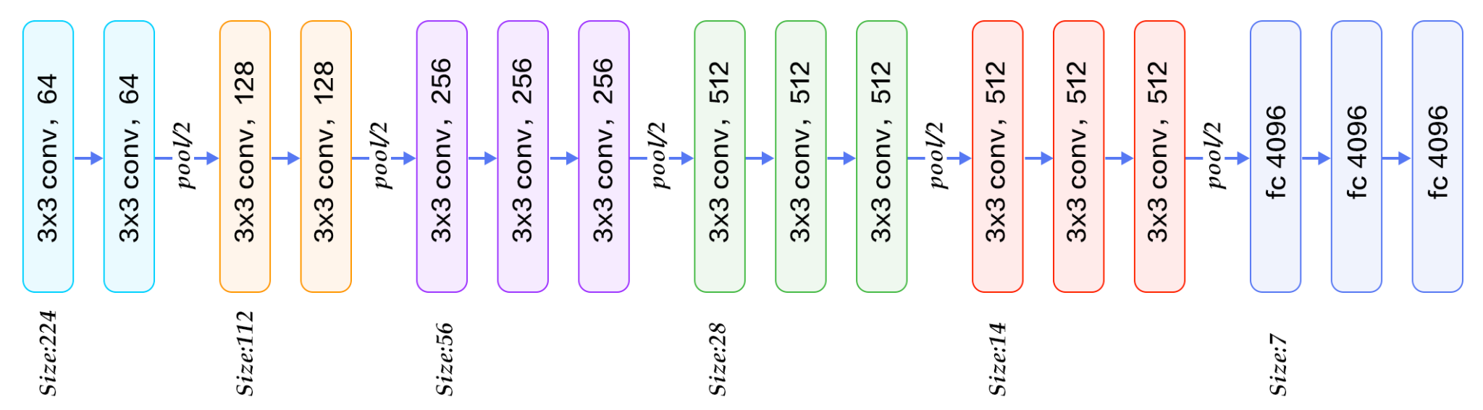
VGG-19
https://www.quora.com/What-is-the-VGG-neural-network

Slide 22
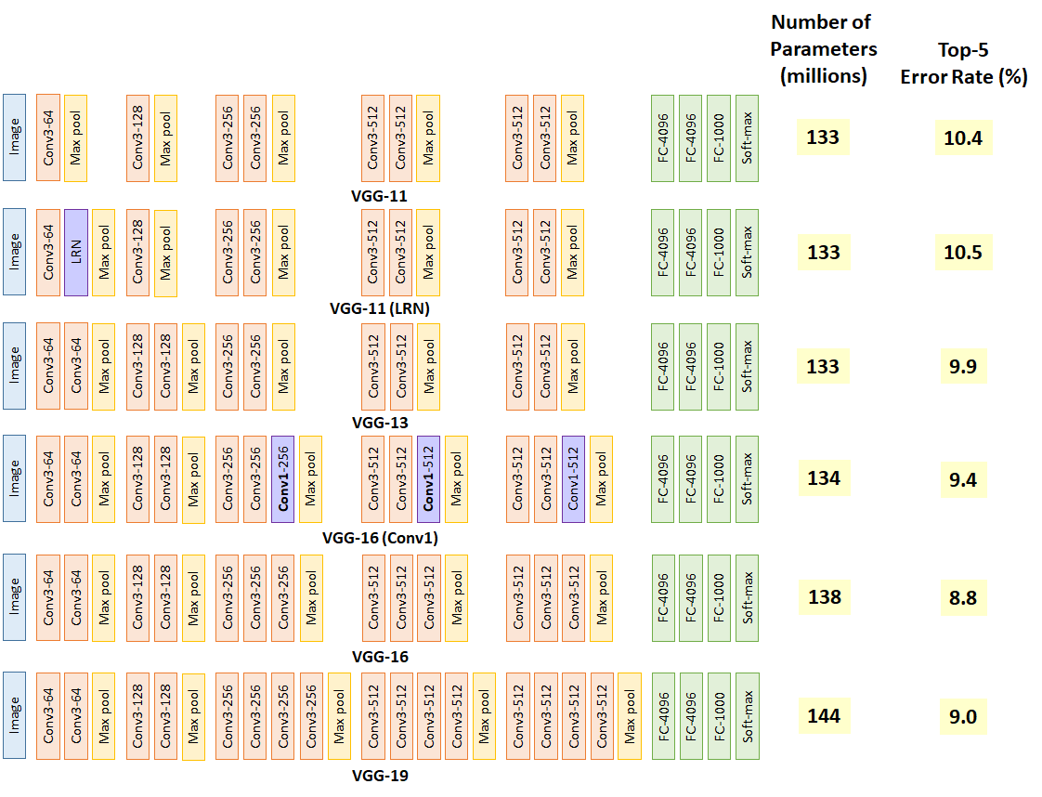
VGG / Ablation Study
https://medium.com/coinmonks/paper-review-of-vggnet-1st-runner-up-of-ilsvlc-2014-image-classification-d02355543a11

Slide 23
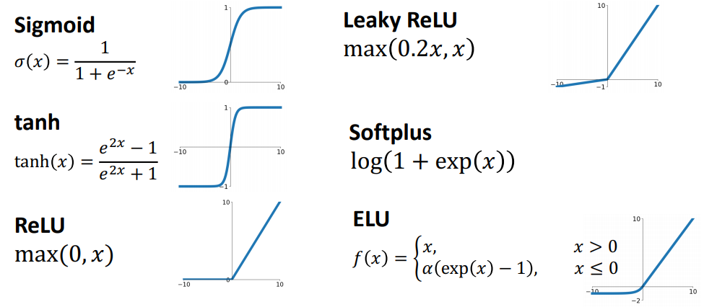
Funciones de Activación
https://web.eecs.umich.edu/~justincj/slides/eecs498/FA2020/598_FA2020_lecture05.pdf

Slide 24
Funciones de Activación
https://web.eecs.umich.edu/~justincj/slides/eecs498/FA2020/598_FA2020_lecture05.pdf

Slide 25
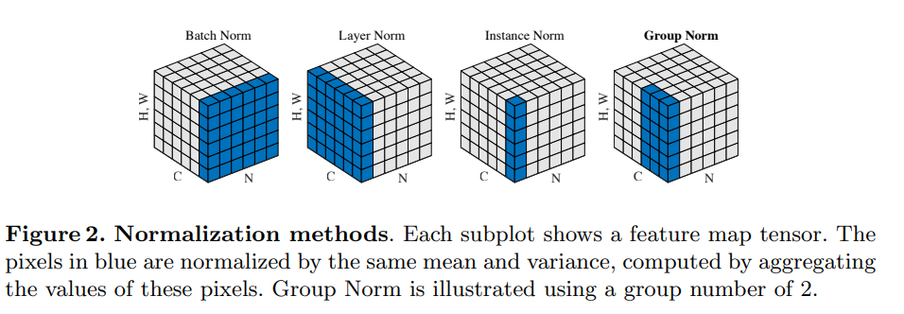
Normalización
Wu, Y., & He, K. (2018). Group normalization. In Proceedings of the European conference on computer vision (ECCV) (pp. 3-19).

Slide 26
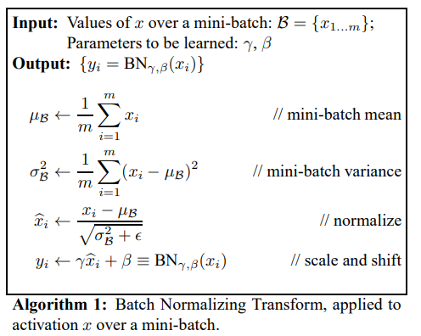
Normalización: Batch
Ioffe, S., & Szegedy, C. (2015, June). Batch normalization: Accelerating deep network training by reducing internal covariate shift. In International conference on machine learning (pp. 448-456). PMLR.
https://towardsdatascience.com/batch-normalization-in-3-levels-of-understanding-14c2da90a338

Slide 27
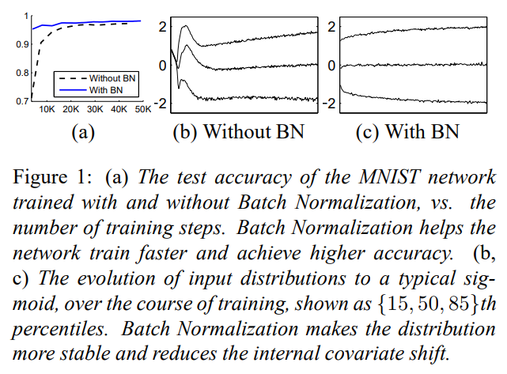
Normalización: Batch
Ioffe, S., & Szegedy, C. (2015, June). Batch normalization: Accelerating deep network training by reducing internal covariate shift. In International conference on machine learning (pp. 448-456). PMLR.
https://towardsdatascience.com/batch-normalization-in-3-levels-of-understanding-14c2da90a338

Slide 28
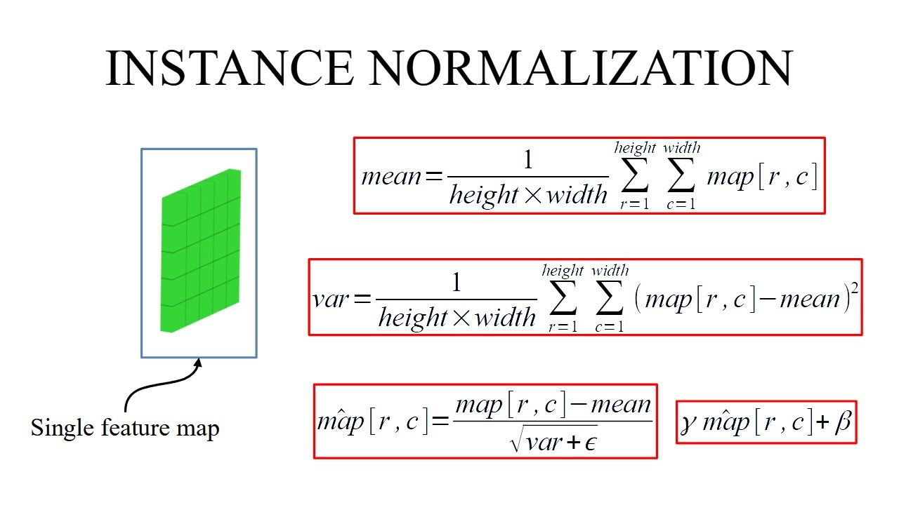
Normalización: Instance
https://i.ytimg.com/vi/YG60dtlLfGo/maxresdefault.jpg

Slide 29
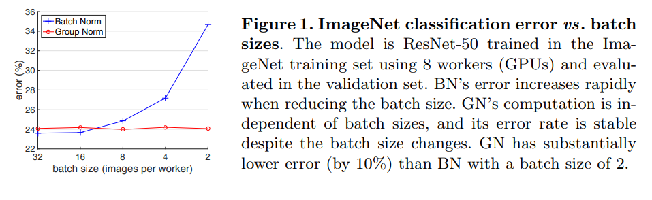
Normalización: Group
Wu, Y., & He, K. (2018). Group normalization. In Proceedings of the European conference on computer vision (ECCV) (pp. 3-19).

Slide 30
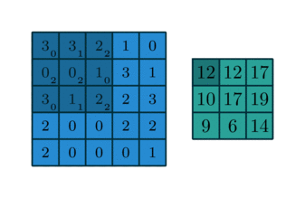
Aritmética Convolucional: Convolución Discreta
input feature map
kernel
https://theano-pymc.readthedocs.io/en/latest/tutorial/conv_arithmetic.html

Slide 31

Aritmética Convolucional: Convolución Discreta
stride = 1
padding = 0
filter_size = 3
input_size = 4
https://theano-pymc.readthedocs.io/en/latest/tutorial/conv_arithmetic.html

Slide 32
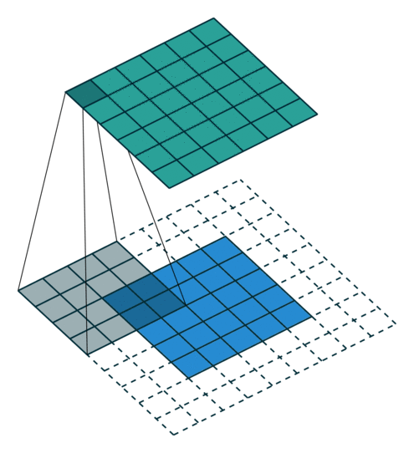
Aritmética Convolucional: Zero Padding
stride = 1
padding = 1
filter_size = 4
input_size = 5
https://theano-pymc.readthedocs.io/en/latest/tutorial/conv_arithmetic.html

Slide 33


Aritmética Convolucional: padding = ‘same’
stride = 1
zero_padding = 1
filter_size = 4
input_size = 5
https://theano-pymc.readthedocs.io/en/latest/tutorial/conv_arithmetic.html

Slide 34
Aritmética Convolucional: padding = ‘same’
stride = 1
zero_padding = ??
filter_size = 3
input_size = 5
impar
p
https://theano-pymc.readthedocs.io/en/latest/tutorial/conv_arithmetic.html

Slide 35
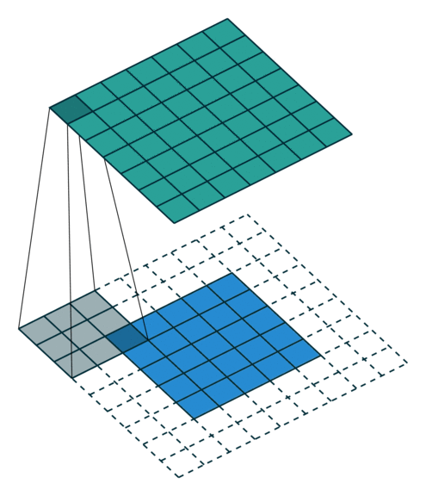

Aritmética Convolucional: Full Padding
Todas las sobreposiciones posibles
stride = 1
zero_padding = filter_size - 1
filter_size = 3
input_size = 5
https://theano-pymc.readthedocs.io/en/latest/tutorial/conv_arithmetic.html

Slide 36


Aritmética Convolucional: No-Padding, stride > 1
stride = 2
zero_padding = 0
filter_size = 3
input_size = 5
https://theano-pymc.readthedocs.io/en/latest/tutorial/conv_arithmetic.html

Slide 37
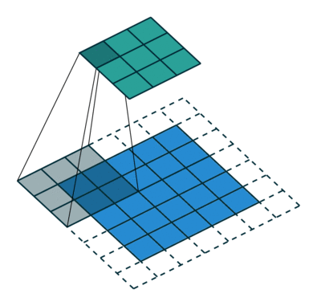

Aritmética Convolucional: padding > 0, stride > 1
stride = 2
zero_padding = 1
filter_size = 3
input_size = 5
https://theano-pymc.readthedocs.io/en/latest/tutorial/conv_arithmetic.html

Slide 38
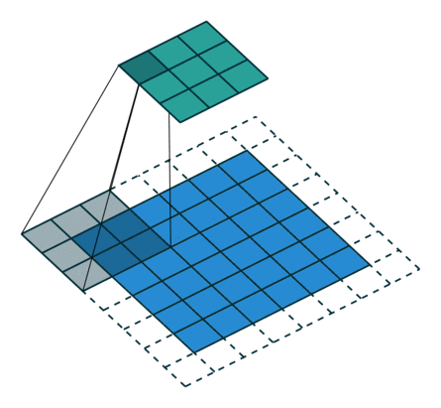
Aritmética Convolucional: padding > 0, stride > 1
stride = 2
zero_padding = 1
filter_size = 3
input_size = 6
https://theano-pymc.readthedocs.io/en/latest/tutorial/conv_arithmetic.html

Slide 39
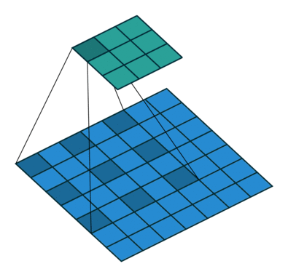

Aritmética Convolucional: Dilated (atrous) Convolutions
stride = 1
zero_padding = 0
dilation = 2
filter_size = 3
input_size = 7
https://theano-pymc.readthedocs.io/en/latest/tutorial/conv_arithmetic.html

Slide 40
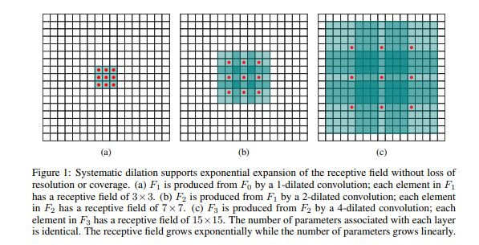
Aritmética Convolucional: Dilated (atrous) Convolutions
Yu, F., & Koltun, V. (2015). Multi-scale context aggregation by dilated convolutions. arXiv preprint arXiv:1511.07122.

Slide 41
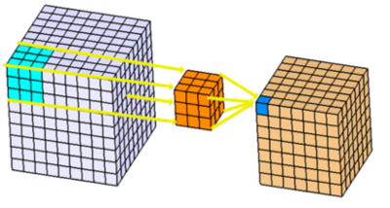
Aritmética Convolucional: Generalizable
https://www.kaggle.com/shivamb/3d-convolutions-understanding-use-case

Slide 42
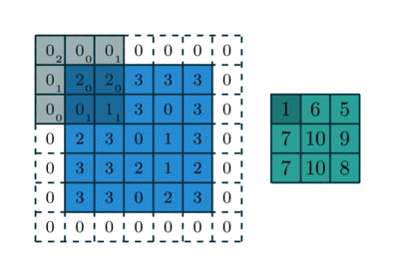
Aritmética Convolucional: 3x3 kernel aplicado a una imagen de 5x5 con zero padding = 1 y strides 2x2
https://theano-pymc.readthedocs.io/en/latest/tutorial/conv_arithmetic.html

